Slide 1
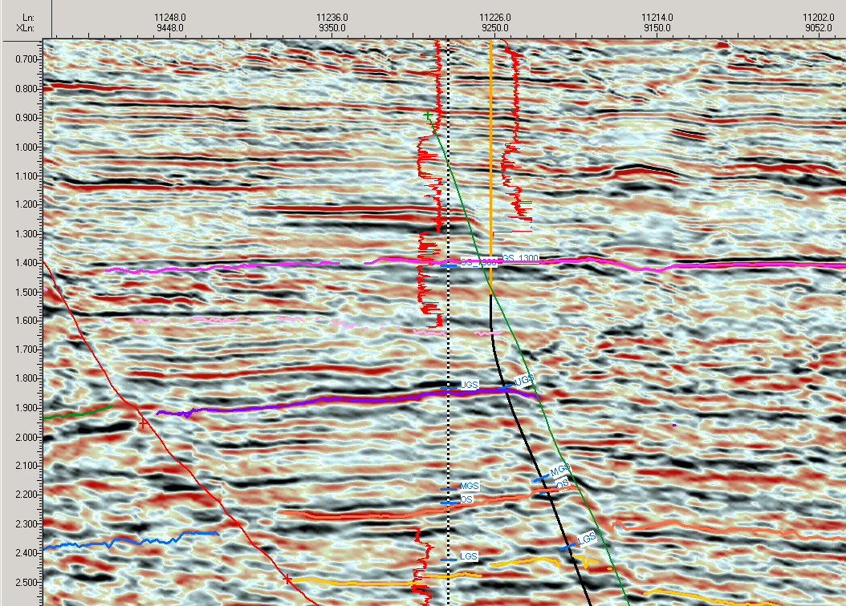
Morning report 15 dec 2005, No MWD,
Gold is actual, black is planned.
Gas reading 708 : 1312 m
13 3./8 casing point.
Fault penetrated?

Slide 2
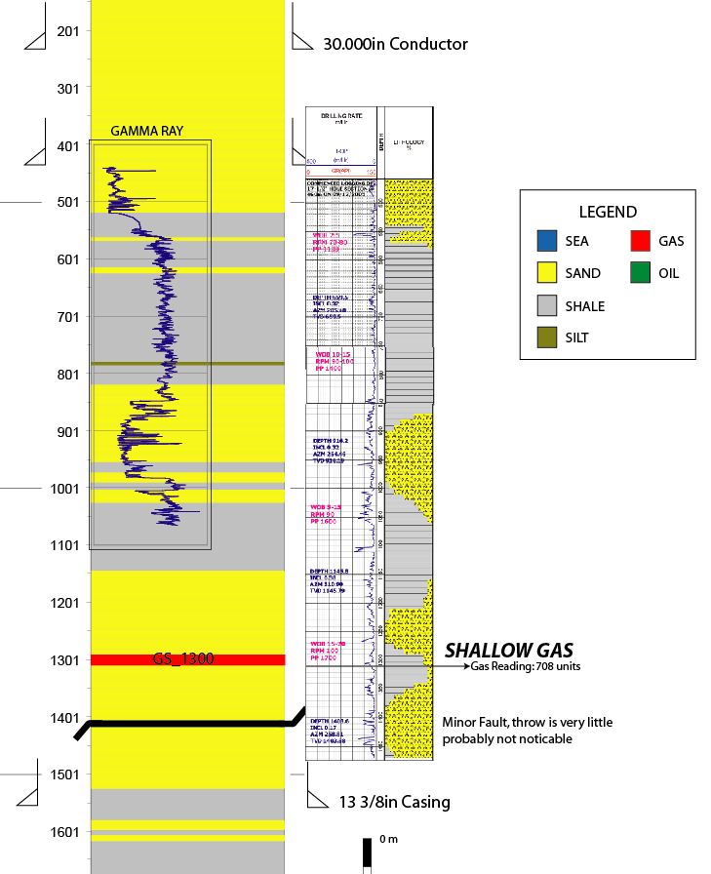
Predicted Bilabri-DX1 log (Y- RAY on top) versus Mudlog

Slide 3
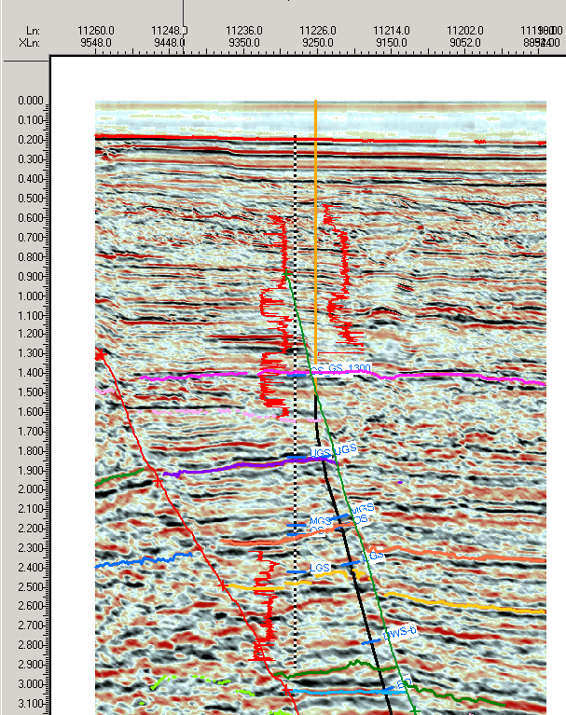
14-12-2005: Morning report
- Bilabri-1
Planned trajectory
Current trajectory
Gamma Ray failed
Gamma Ray missing in Payzone

